Slide 1

Note: The data and information in this document is reflective of a hypothetical situation and client. This document is to be used for KPMG Virtual Internship purposes only.
Sprocket Central Pty Ltd
Data analytics approach
[Division Name] - [Engagement Manager], [Senior Consultant], [Junior Consultant]

Slide 2
Note: The data and information in this document is reflective of a hypothetical situation and client. This document is to be used for KPMG Virtual Internship purposes only.
Agenda
Introduction
Data Exploration
Model Development
Interpretation

Slide 3
Note: The data and information in this document is reflective of a hypothetical situation and client. This document is to be used for KPMG Virtual Internship purposes only.
Introduction
The following are the steps taken in determining the target consumer.
Data Exploration
Gender & Age Distribution
Wealth Segment & Job Industry Distribution
Customers Map
Model Development
Bike-related purchased vs. Segment
Bike-related purchased vs. Gender
Interpretation
Customer Segment

Slide 4
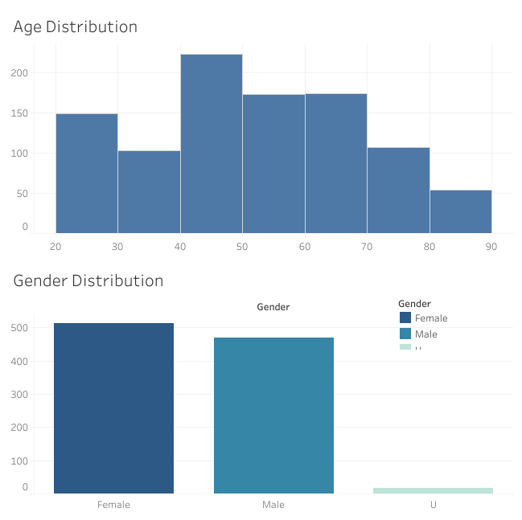
Note: The data and information in this document is reflective of a hypothetical situation and client. This document is to be used for KPMG Virtual Internship purposes only.
Data Exploration
Customer Characteristics
Gender & Age Distribution
Majority customers is Female
Difference between Male and Female customers is 33.
Majority group age of customer is 40-60 years old.
17 data has DOB null values.

Slide 5
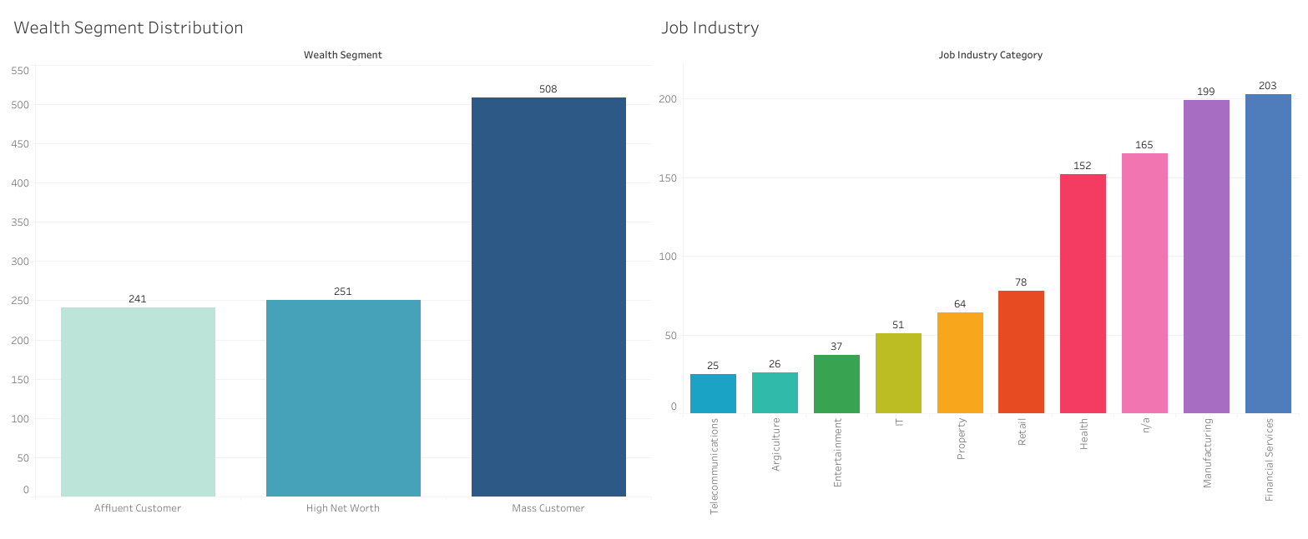
Note: The data and information in this document is reflective of a hypothetical situation and client. This document is to be used for KPMG Virtual Internship purposes only.
Data Exploration
Customer Characteristics
Wealth Segment & Job Industry Distribution
Customer segments dominated by Mass Customer.
Mass Customers percentage is about two times Affluent/High Net Worth Customer.
Data has many uncategorized job industry (165 customers)

Slide 6
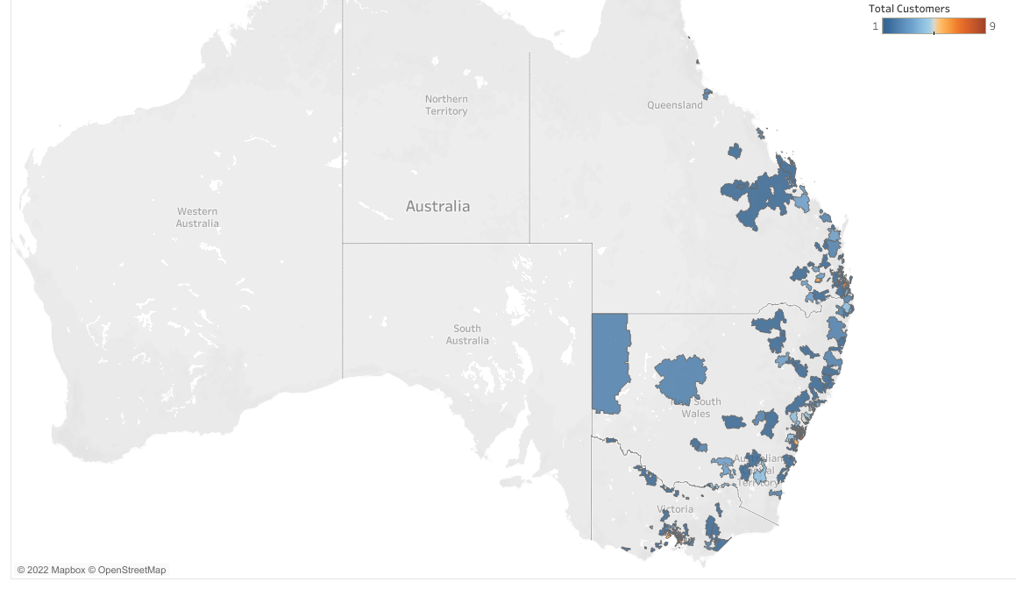
Note: The data and information in this document is reflective of a hypothetical situation and client. This document is to be used for KPMG Virtual Internship purposes only.
Data Exploration
Customers Map
Consumers are centered in each area close to the state capital and the market only covering Eastern Australia.

Slide 7
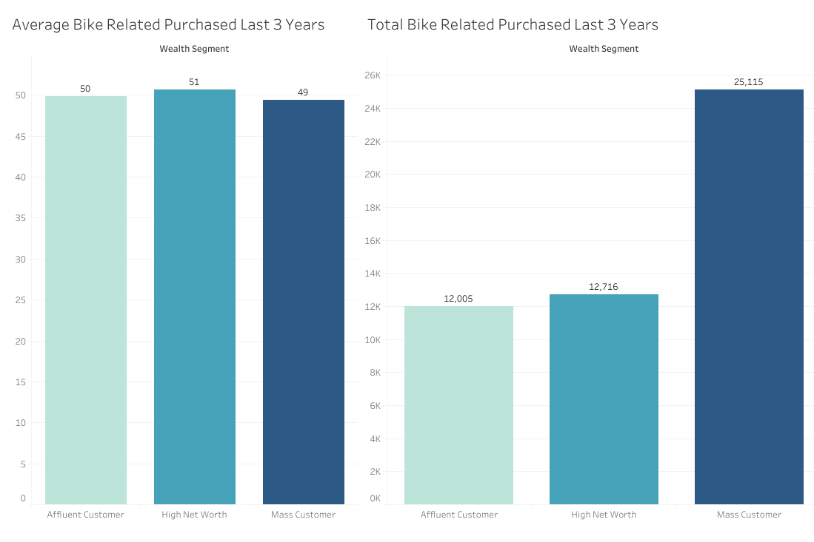
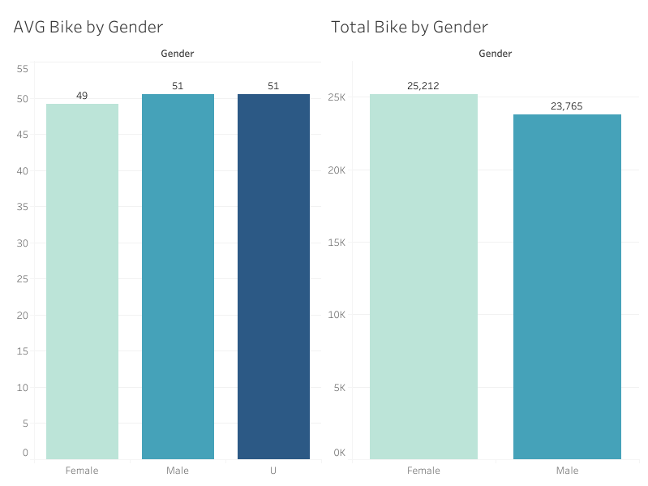
Note: The data and information in this document is reflective of a hypothetical situation and client. This document is to be used for KPMG Virtual Internship purposes only.
Model Development
Bike Purchase vs. Segment
Bike Purchase vs. Gender
Each segment has the same average purchase of bicycles in the last 3 years.
Because customers are dominated by the Mass Customer segment, the number of bicycle purchases is also dominated by this segment.
Customers also dominated by Female, so the number of bicycle purchases by Female is more than bicycle purchases by Male.

Slide 8
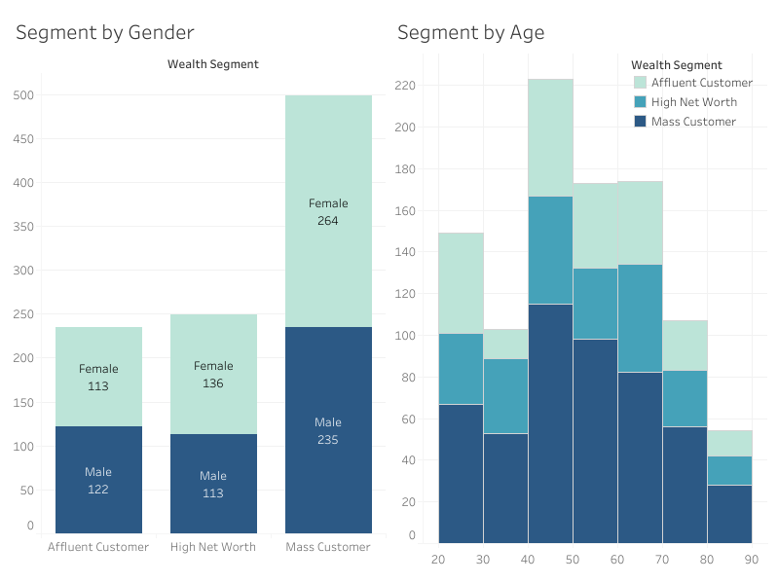
Note: The data and information in this document is reflective of a hypothetical situation and client. This document is to be used for KPMG Virtual Internship purposes only.
Interpretation
Customer Segment
The average purchases across the various segments are the same, but Mass Customers have the most total purchases. So we need to focus on customers categorized as Mass Customers.
Gender differences in numbers and purchases by gender are also small, so gender is not of particular concern.
The age range is dominated by consumers aged 40-60 years old. So we need to target consumers between the ages of 40-60 years old.

